Slide 1
Cyberbullying Detection on Social Networks Using Hybrid RNN-LSTM Model

Slide 2
Introduction
Cyberbullying affects millions worldwide, causing emotional distress and harm .Social networks struggle to detect and prevent online harassment .Traditional methods rely on manual reporting, which is time-consuming and ineffective.
This presentation proposes a novel solution: a hybrid RNN-LSTM model.
Through this innovative approach , we aim to contribute significantly to the ongoing efforts in creating safer environments.

Slide 3
Web Scrapping
Web scraping, also known as web harvesting or web data extraction, is the process of automatically extracting data from websites. This is typically done using software tools or scripts that simulate human browsing to collect data from web pages.
It Enables gathering large volumes of information quickly, which can be used for various applications like market research, data analysis, competitive analysis, etc.
We have webscrapped the text from youtube via youtube data API v3 and from reddit using PRAW(Python Reddit API wrapper).

Slide 4
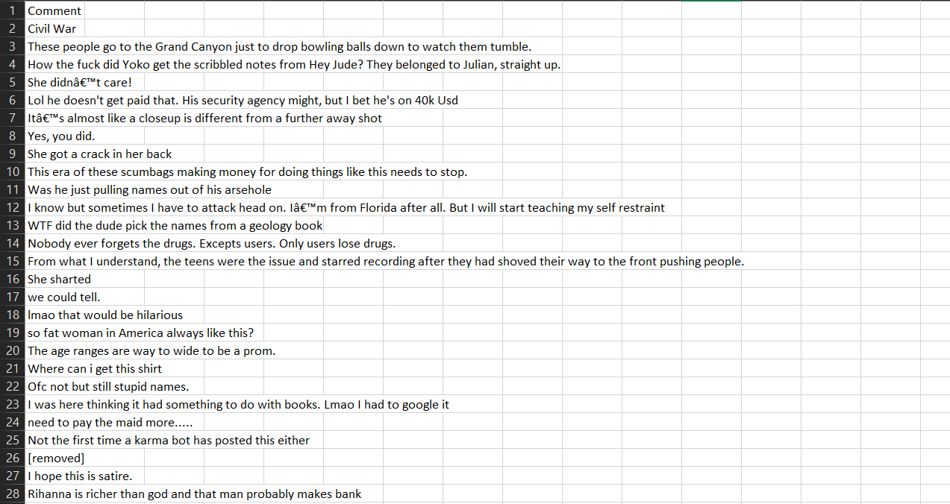
Data Collection
We used code to gather comments from a YouTube video and saves them to a CSV file. It uses the YouTube API and handles errors, pagination, and comment processing. The code retrieves main comments and replies, organizes them into a table, and saves it to a CSV file. This results in a file with each comment on its own row, easy to review or analyze.

Slide 5
Labelling
Labelling, also known as data annotation or tagging, is a crucial step in preparing datasets for machine learning, especially when dealing with text data. This process involves assigning labels to data points based on their characteristics, which helps the machine learning model learn to classify or predict data effectively.
The labelling part has done manually.
We have labelled the comments as:
Cyberbullying as 1
Non-cyberbullying as 0

Slide 6
Preprocessing steps
1. Text Lowercasing: Converts all text to lowercase.
2. Number Removal: Removes all numbers from the text.
3. Punctuation Removal: Removes all punctuation marks from the text.
4. Extra Space Removal: Removes extra spaces from the text.
5. URL Removal: Removes all URLs from the text.
6. Mention Removal: Removes all mentions (e.g., @username) from the text.
7. Stopword Removal: Removes all stopwords (common words like "the", "and", etc.) from the text.
8. Emojis: Remove all emojis from the text.

Slide 7
Stage 1
Done with web scrapping ,labelling and preprocessing the dataset.
Stage 3
We had trained RNN-LSTM on the dataset to check the accuracy and pick the best model.
Stage 2
We have trained the dataset with the help of some models like Logistic Regression and Random Forest Classifier.
Stage 4
We had created a GUI where the user can give input so that it predicts the input is Cyber bullying or not.

Slide 8
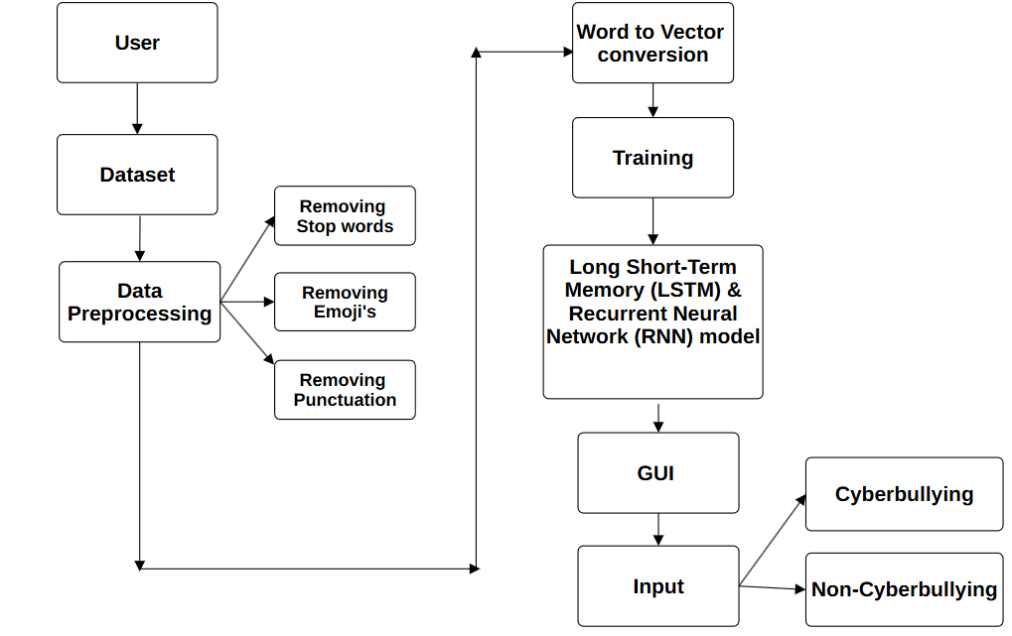
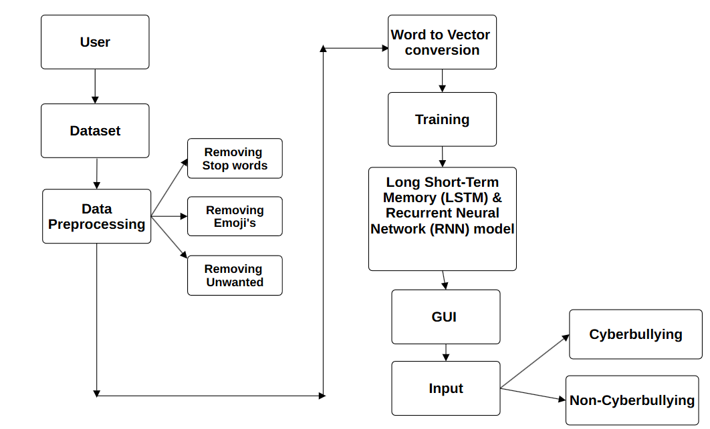
FLOW CHART

Slide 9
Models Used
An LSTM (Long Short-Term Memory) is a special kind of RNN designed to remember information over long sequences and avoid the vanishing gradient problem, which is critical when dealing with long text sequences like the comments in your application.
Advantages
LSTM Solution: LSTMs are designed with a special internal structure (gates and memory cells) that allows them to "remember" information over long sequences
Time-Series Data: LSTMs are well-suited for time-series forecasting and other types because they are designed to process inputs over time, maintaining context and learning from previous time steps.
Text Generation and Language Models: LSTMs are widely used for generating coherent text.

Slide 10
Recurrent Neural Network (RNN) is a type of neural network designed to handle sequential data by maintaining information about previous inputs through a form of memory. Unlike traditional feedforward neural networks, RNNs have a "recurrent" connection that allows them to use outputs from previous time steps as inputs for the current step.
Advantages
Sequential Nature: RNNs are designed to process sequential data.
Hidden States: The key feature of RNNs is their ability to pass information through hidden states.
Weight Sharing: Unlike traditional feedforward networks, RNNs share the same weights at each time step.

Slide 11
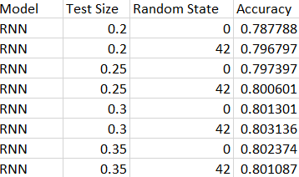
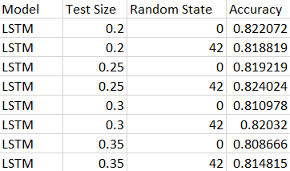
Accuracy highest accuracy for LSTM model is 82.40% highest accuracy for RNN model is 80.31% RNN LSTM

Slide 12
Cyberbullying Comment Detector - GUI Overview
The Cyberbullying Comment Detector web application features a clean and user-friendly interface built with Flask. It uses a visually appealing background image that enhances the overall user experience. The core interaction revolves around an input field where users can type a comment for analysis. Two main buttons are provided: Detect, which triggers the comment analysis, and Delete, which clears the input field for a new comment. Once the comment is analyzed, the result display dynamically shows whether the comment is categorized as Cyberbullying or Non-Cyberbullying, with color-coded feedback—red for cyberbullying and green for non-cyberbullying. The layout is fully responsive, adjusting to different screen sizes, ensuring usability on both mobile and desktop devices. Overall, the interface is designed to provide an intuitive and engaging user experience with clear instructions and smooth transitions.

Slide 13
Deployment Steps
Upload Project to GitHub
Sign Up or Log In to Render
Create a New Web Service
Connect GitHub Repository
Enter Service Details
Set Build and Start Commands
Deploy the Service
Wait for Deployment Completion
Access the Deployment URL To Test Your Application

Slide 14
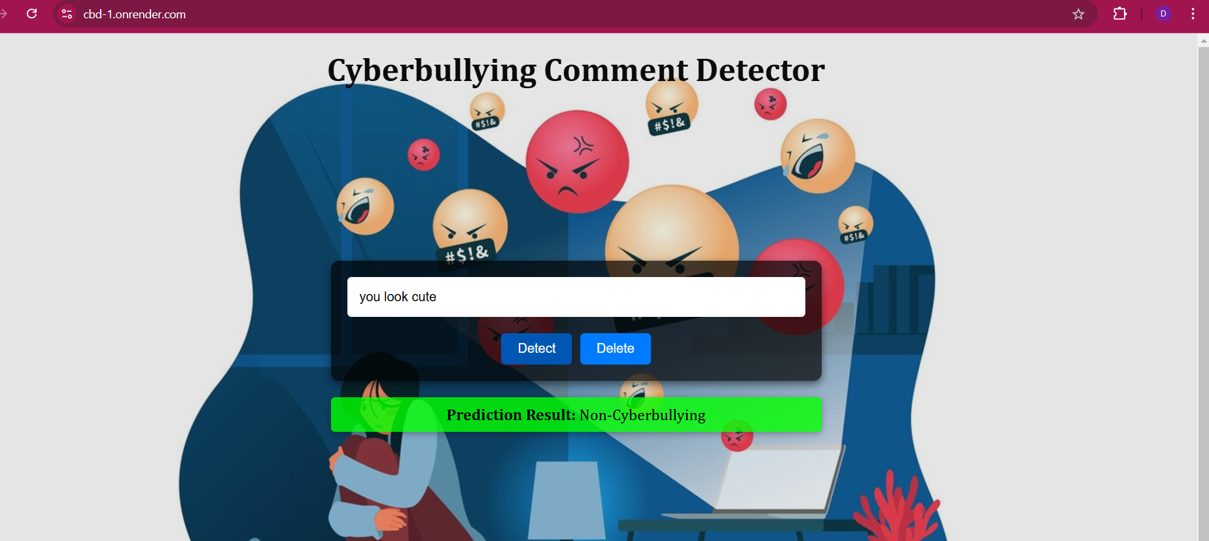

Slide 15
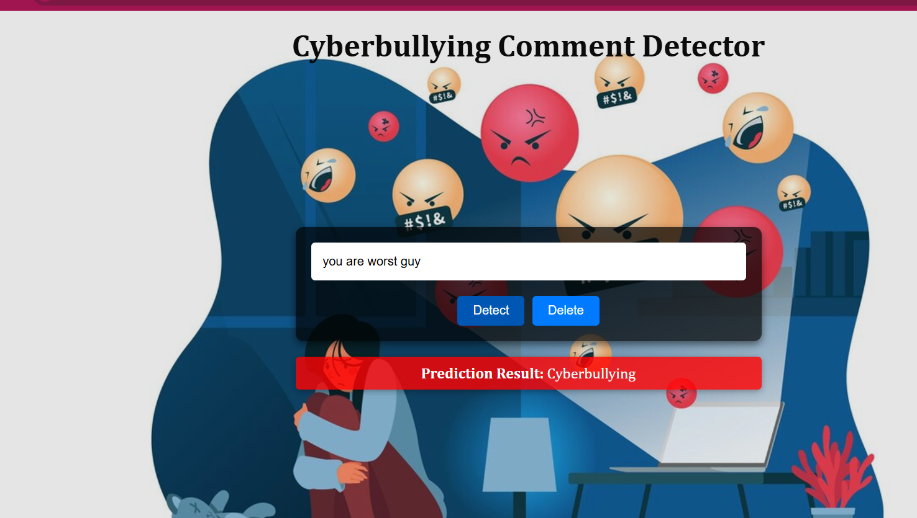

Slide 16
CONCLUSION
Cyberbullying Comment Detector app is an effective tool for identifying harmful comments and promoting a safer online environment. By leveraging advanced machine learning models and a user-friendly interface, it allows users to easily input and analyze comments for potential cyberbullying content. this app serves as a valuable resource for detecting cyberbullying and raising awareness about online harassment.

Slide 17
TEAM MEMBERS
CHARAN REDDY
DHANIKSHA
JASMITHA GATTU
MEGHANA REDDY BODDAPATI
NIDHI
PRANAV

